Slide 2
Ratio study
Ratio between the loss functions
Content loss
Adversarial loss

Slide 3
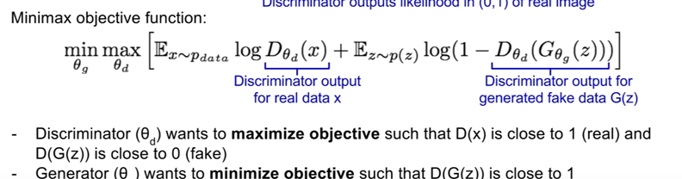
Content loss
‘standard’ error: compare loss between pixels
Mean square error
Adversarial loss
Loss generated from discriminator network

Slide 4
Content loss ->
Fake out -> adversarial loss -> generator loss
-> discriminator loss

Slide 5
Loss = content loss + ratio * adverarial loss
Ratio: 0.1 0.01 0.001 0.00001

Slide 6
Ratio 0.1
Let discriminator dominate the loss

Slide 7
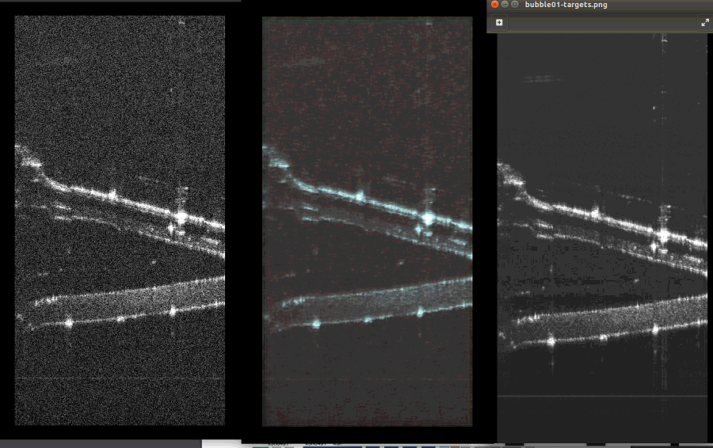

Slide 8
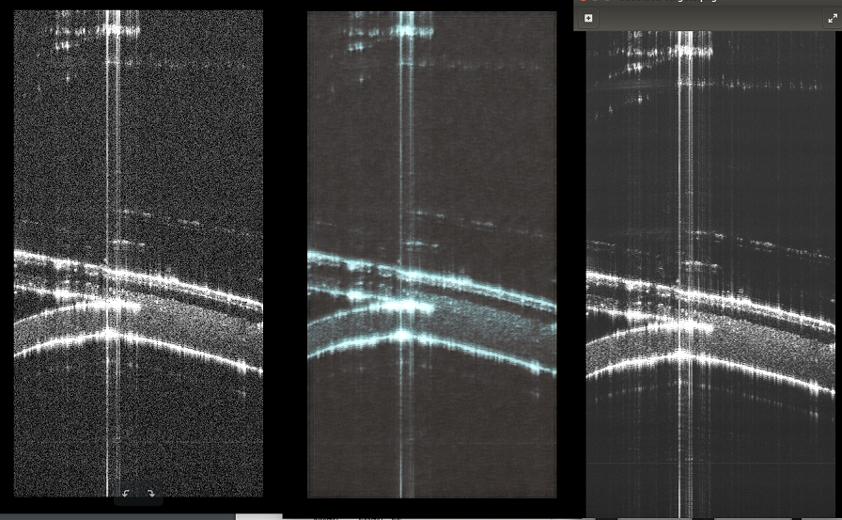

Slide 9
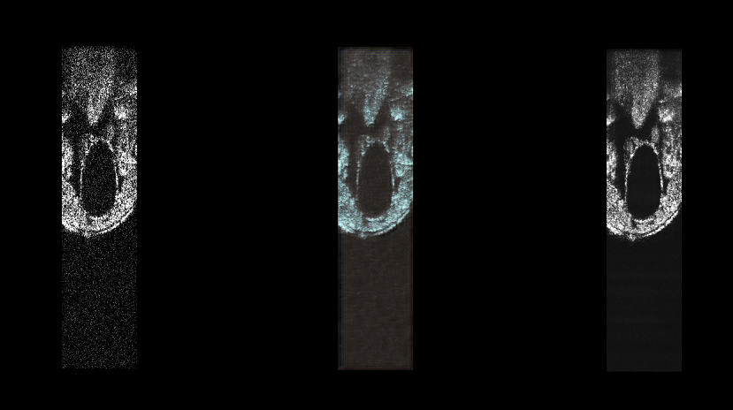

Slide 10
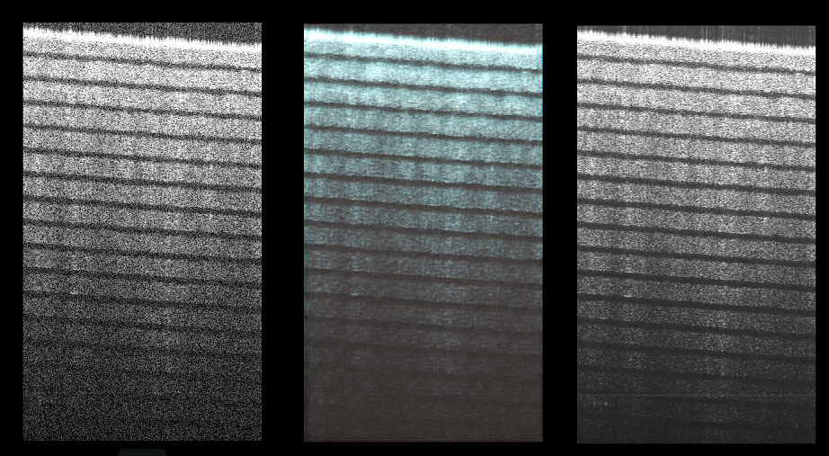

Slide 11
Ratio 0.01
10 times higher than the preset value

Slide 12
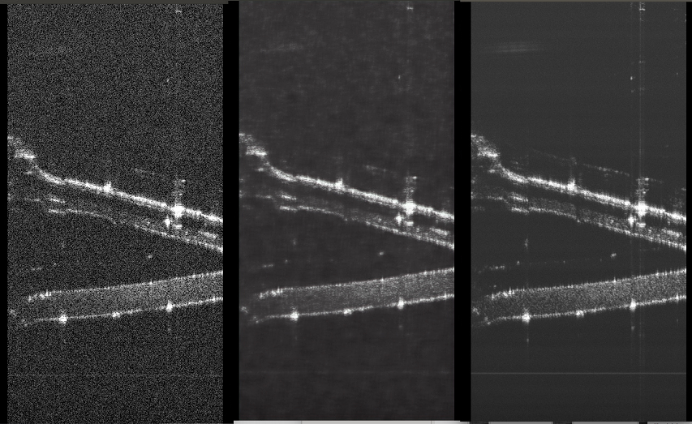

Slide 13
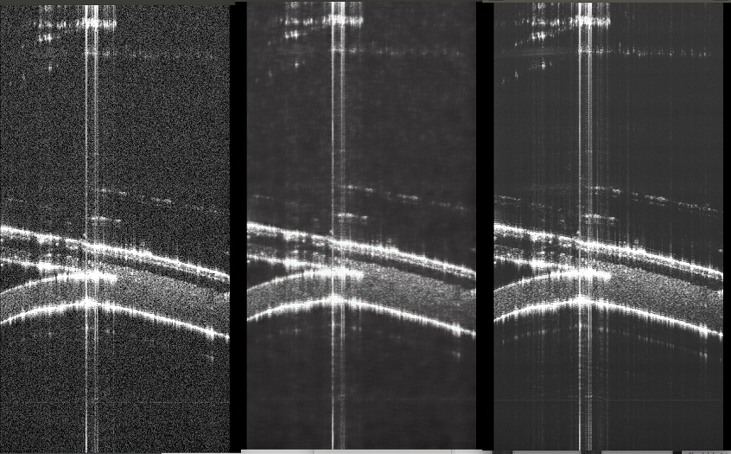

Slide 14
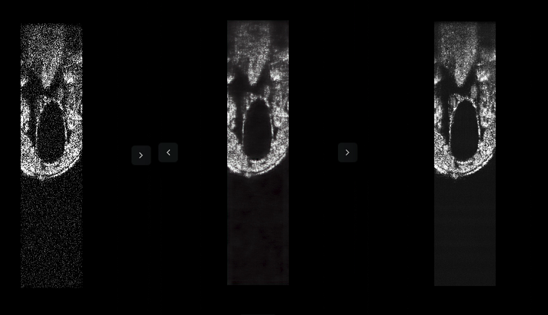

Slide 15
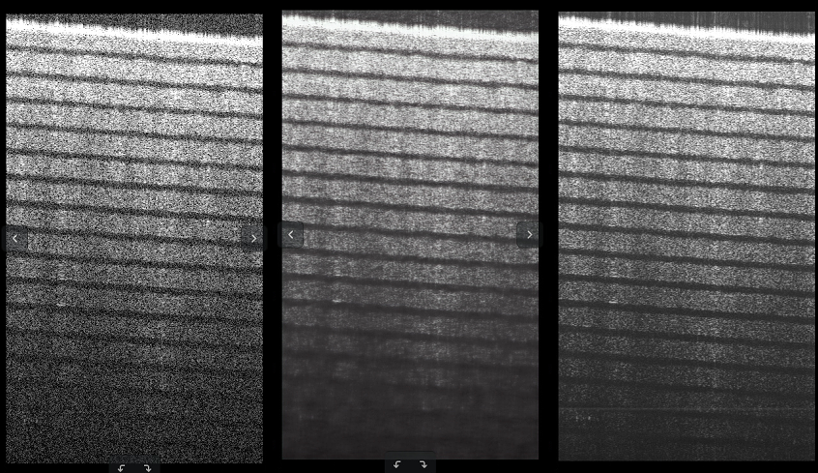

Slide 16
Result 0.00001
Content loss dominate the loss function

Slide 17
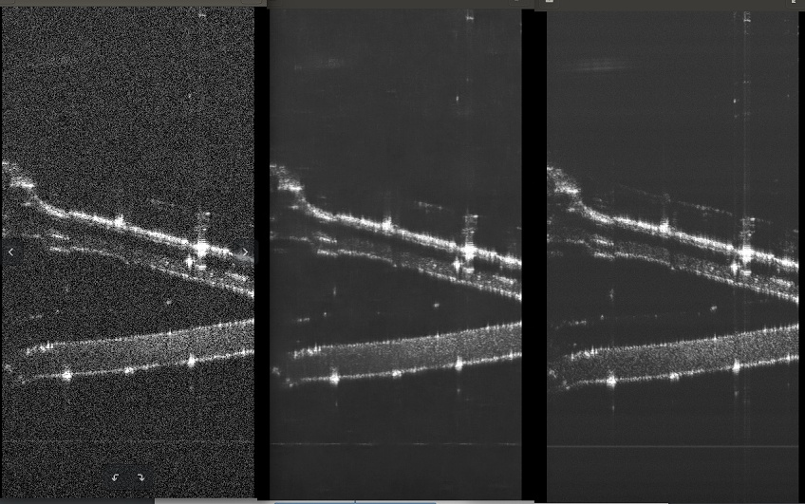

Slide 18
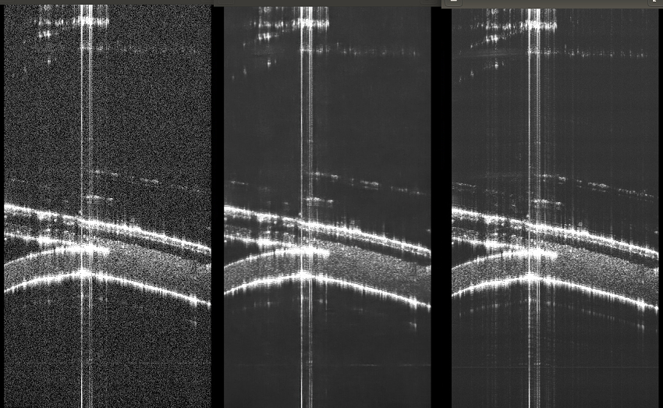

Slide 19
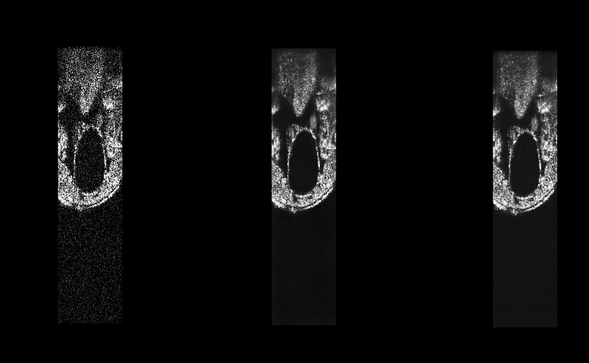

Slide 20
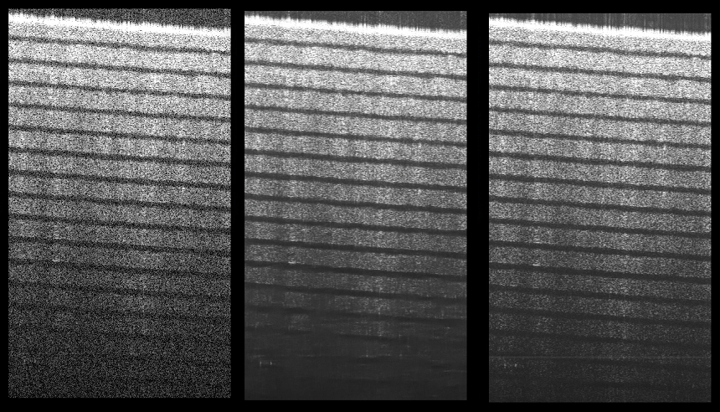

Slide 21
Result 0.001
Preset value of SRGAN network
But ‘content loss’ is different
SRGAN network– content loss is VGG network output
Denoise network– content loss is MSE error ( directly compare the differences between pixels’ ouputs)

Slide 22
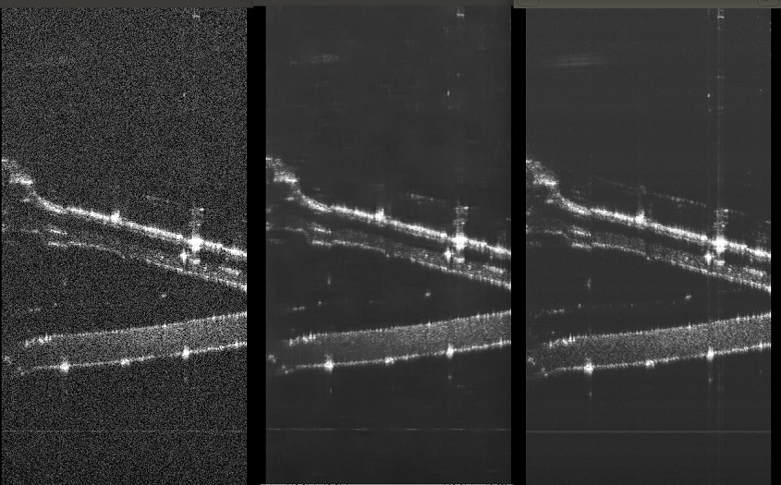

Slide 23
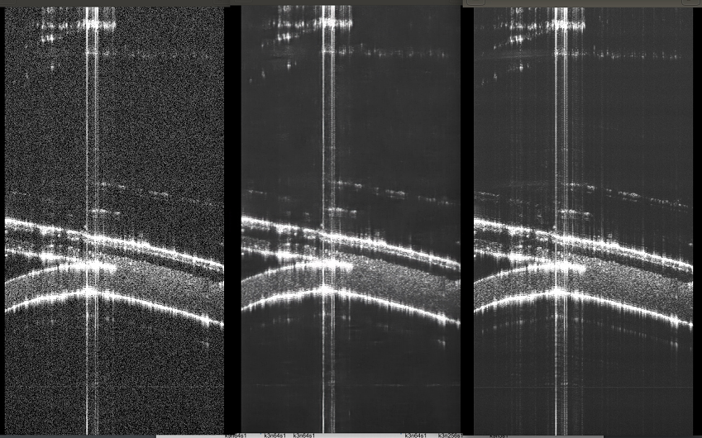

Slide 24
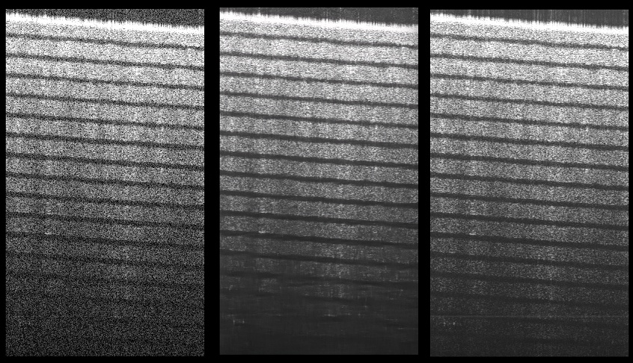

Slide 25
Ratio study: Conclusion
By number: content loss dominates the loss function
Adversarial loss cannot be set to be too large, or result will blur
However, even small portion of adversarial loss would help improve the result
(and the small ratio might not be common, such ratio might be used throughout GAN networks)

Slide 26
Skill study: skip connections
One key issue caused the pooling and conv result to be bad is the lack of SKIP CONNECTIONS
Skip connections are one important technique used in very deep networks
It seems it is also important in the original SRGAN
I am currently study into the characteristics of skip connections

Slide 27
Follow up
Model 0-1 trained with more data

Slide 28
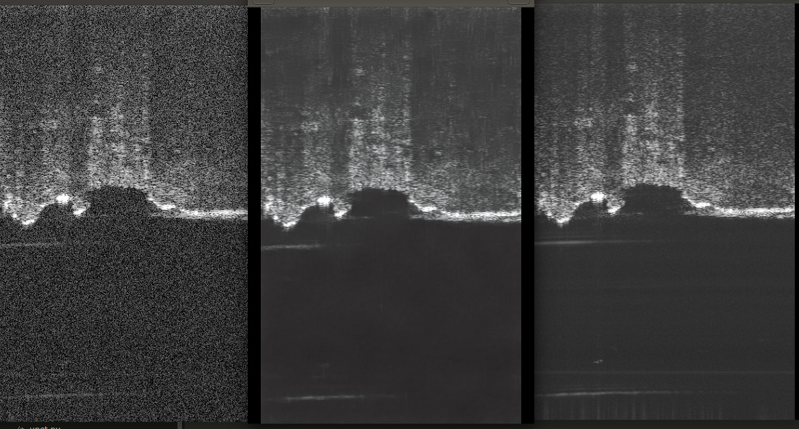

Slide 29
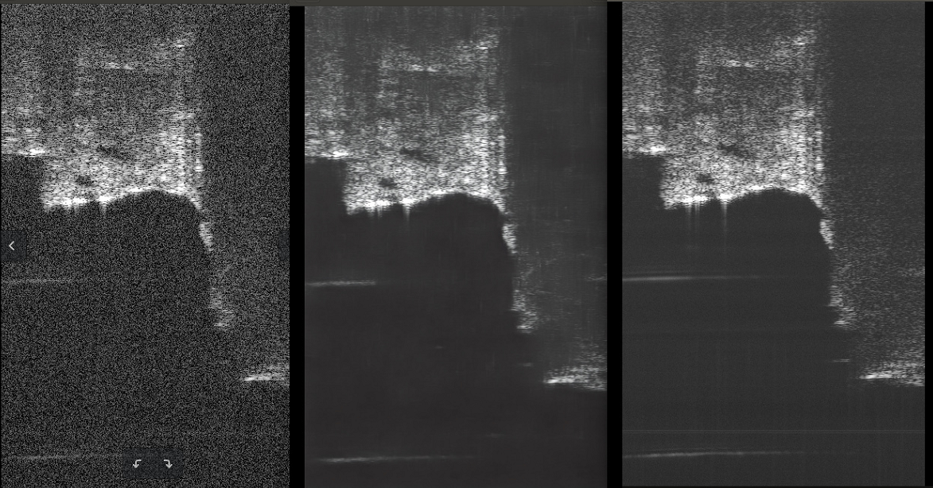

Slide 30
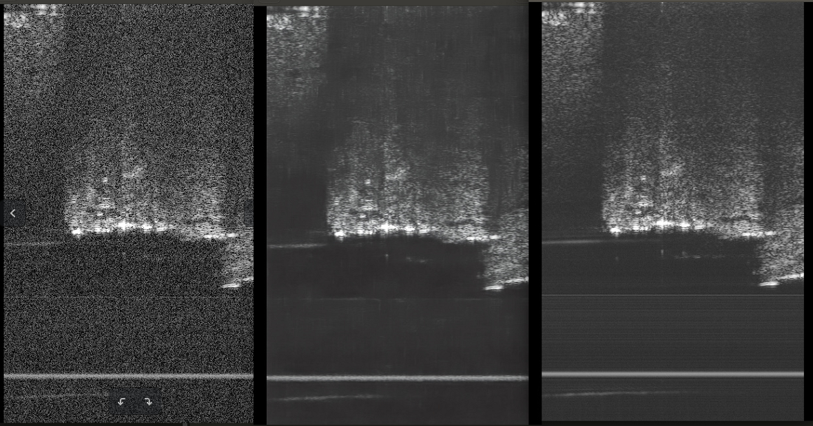

Slide 31
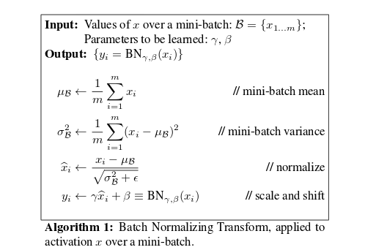
Skills study: batch normalization

Slide 32
Batch normalization
Why use it
Batch normalization reduces the amount by what the hidden unit values shift around
batch normalization allows each layer of a network to learn by itself a little bit more independently of other layers. .

Slide 33

In tensorflow
Tf.slim version of batch norm:

Slide 34
ToDo
model rewrite -> from tf base API to tf.estimator
Tf base API pre trained weight load
Some training and image selection, then start writing paper(meanwhile improving model)

